Slide 1

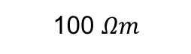

Geotem
Resolve
Tx
NanoTEM
Rx
0
10
100 $Ωm$
30
Depth (m)
10 $Ωm$
150
1 $Ωm$
185

Slide 2
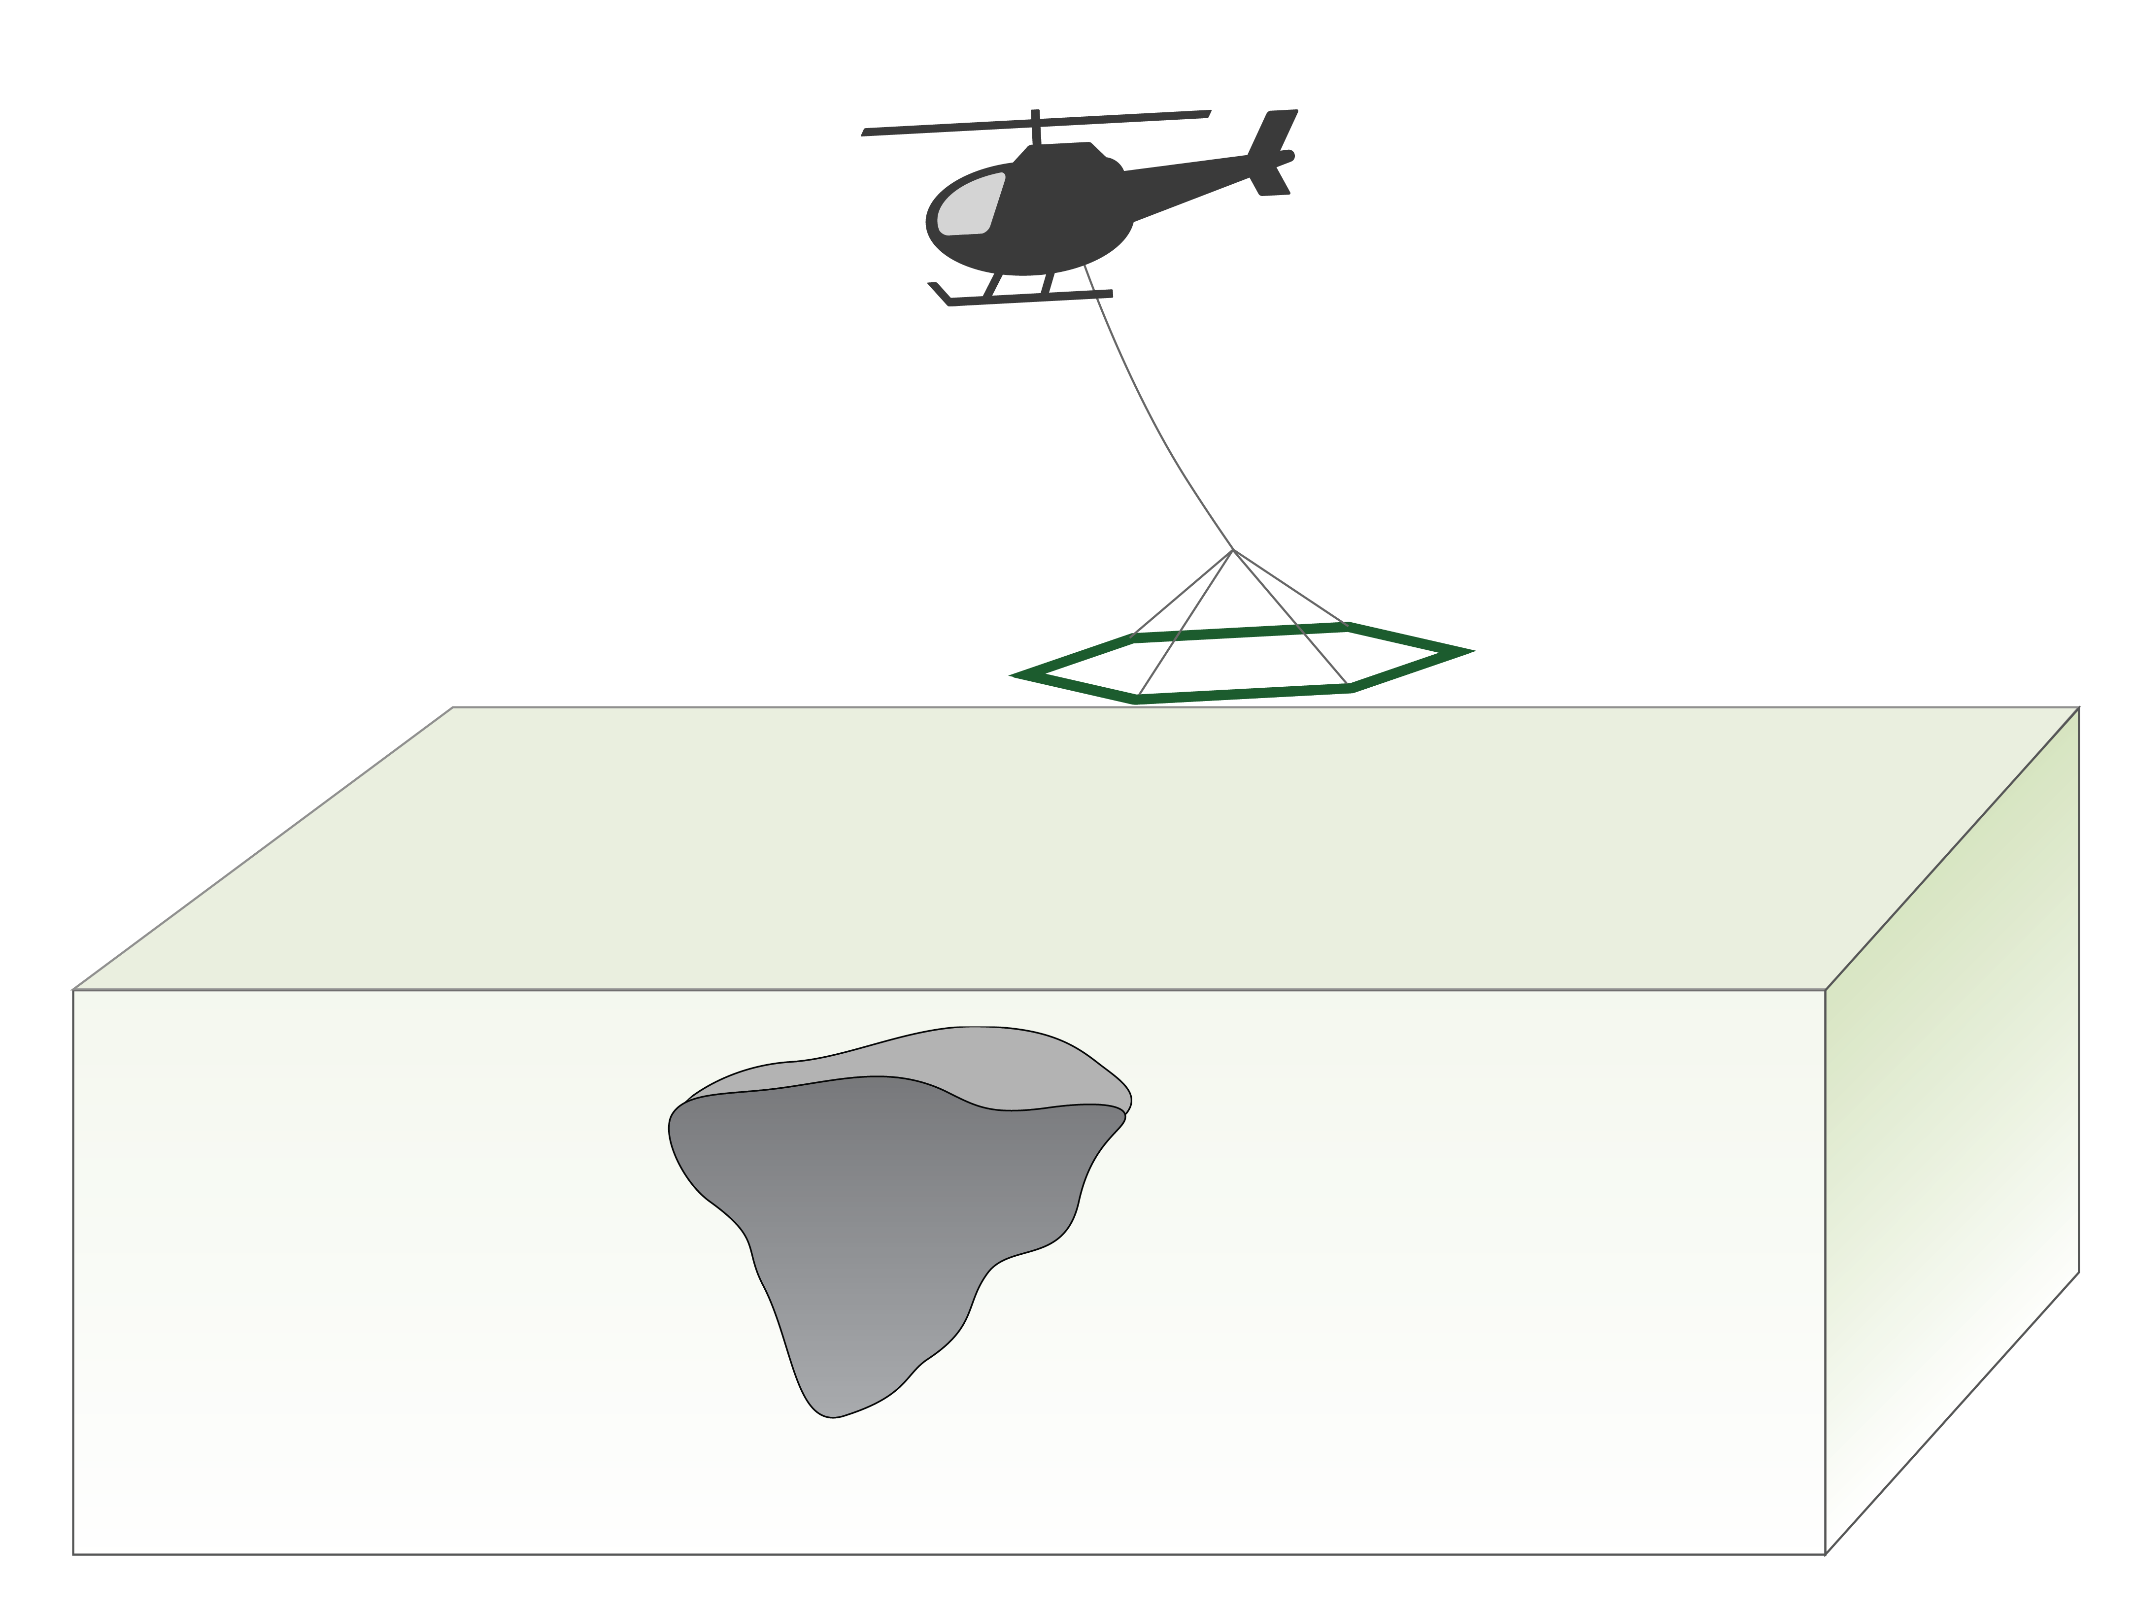

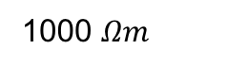
Step-off waveform
30 m height
0
50
Depth (m)
1000 $Ωm$
450
10 $Ωm$

Slide 3
Step-off waveform
30 m height
0
50
Depth (m)
10 Ωm
1000 Ωm
1000 m
450

Slide 4
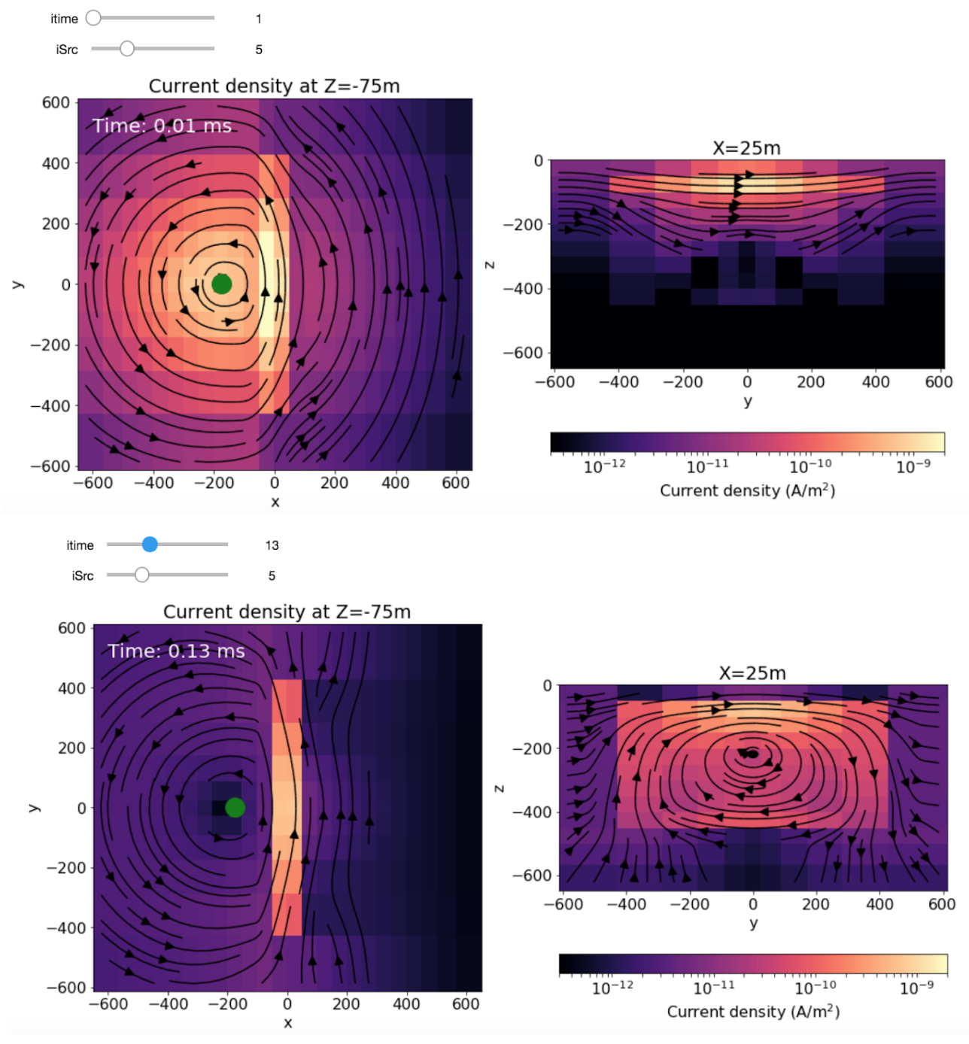
Current density at z = 75m
x = 25m
y (m)
y (m)
Current density (A-m²)
x (m)
Current density at z = 75m
x = 25m
z (m)
y (m)
y (m)
x (m)
Current density (A-m²)

